Slide 1

Mapping NY Healthcare - Dave
Analyzing Medicare and Medicaid Utilization in New York State (2022)

Slide 2
Project Hypothesis - Esha
Comparing Lengths of Stay between Private and Public insurances
Given the known variations in reimbursement rates and patient demographics between Medicare/Medicaid and private insurance, we hypothesize that there will be significant differences in the average length of stay by APR-DRGs between these payer groups. Specifically, we anticipate that patients covered by Medicare/Medicaid will exhibit longer average lengths of stay compared to those covered by private insurance, reflecting potential disparities in resource utilization, care coordination, and discharge planning.

Slide 3
Data Collection - Dave
We found our data on healthdata.gov and followed the source to the NY state website
It was discovered that the dataset was too large to push into GitHub
The free API available was did not offer enough headroom to pull the data
We saved the data locally on each device running the program to circumvent this issue
The data was selected for its completeness and relative cleanliness
Most columns were relevant for the proposed analysis
Very few transformation steps required to make data program-readable
More datasets with further historical data are available for more extensive analysis
Data encompasses all inpatient discharges for the state healthcare system only excluding data points redacted for confidentiality

Slide 4
Data Cleaning - Kamilla
We used Pandas to remove unused data to ensure confidentiality and further increase the efficiency of our code
Removing all extraneous columns was done with drop functions
A dataframe containing all the patient information that had been redacted was created and used to exclude this set from the master data

Slide 5
Data Transformation - Esha Python
Map each hospital location with lat/long
Create summary table by Facility Name using groupby
Used for map marker pop-ups
Create summary table by Facility Name and Payment Typology
Used for heatmaps
Create a summary table by Facility Name and include Gender, APR MDC Description
Used for pie chart, bar graph, and scatterplot
Send all dataframes to CSV and store in Resource folder

Slide 6
Data Transformation - Dave HTML & JavaScript
HTML
Multiple pages were created to display our visualized data
Leaflet and D3
Formatting for visualizations
Optimization
JavaScript
Lat/Long dictionary
Leaflet
Markers and maps
Heatmap
Data Dashboard

Slide 7
Data Visualization
Using JavaScript and HTML we created three visualizations
Filterable data dashboard with a charge vs payment bar graph and gender mix pie chart for all facility-level data
Map with markers showing relevant data
Heatmap showing concentration of government-provided healthcare

Slide 8
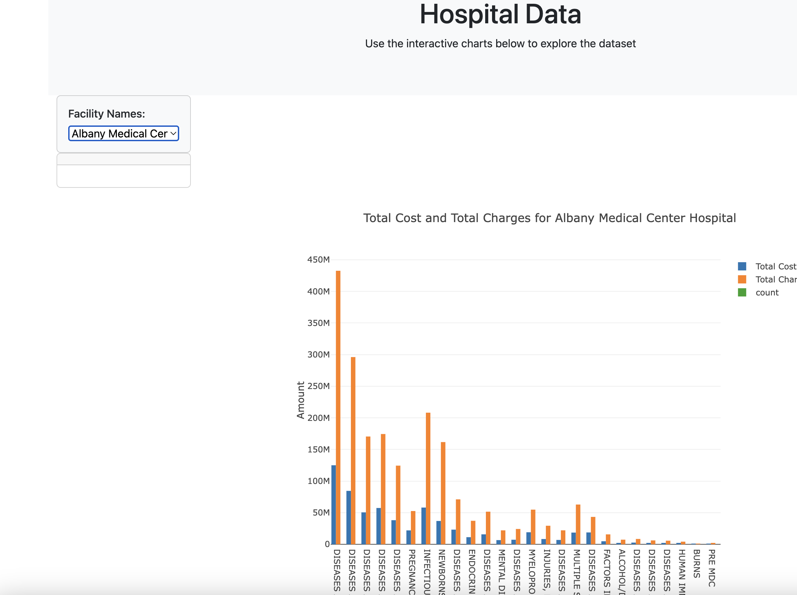
Data Dashboard
Compares Total Cost and Total Charges by admission type

Slide 9
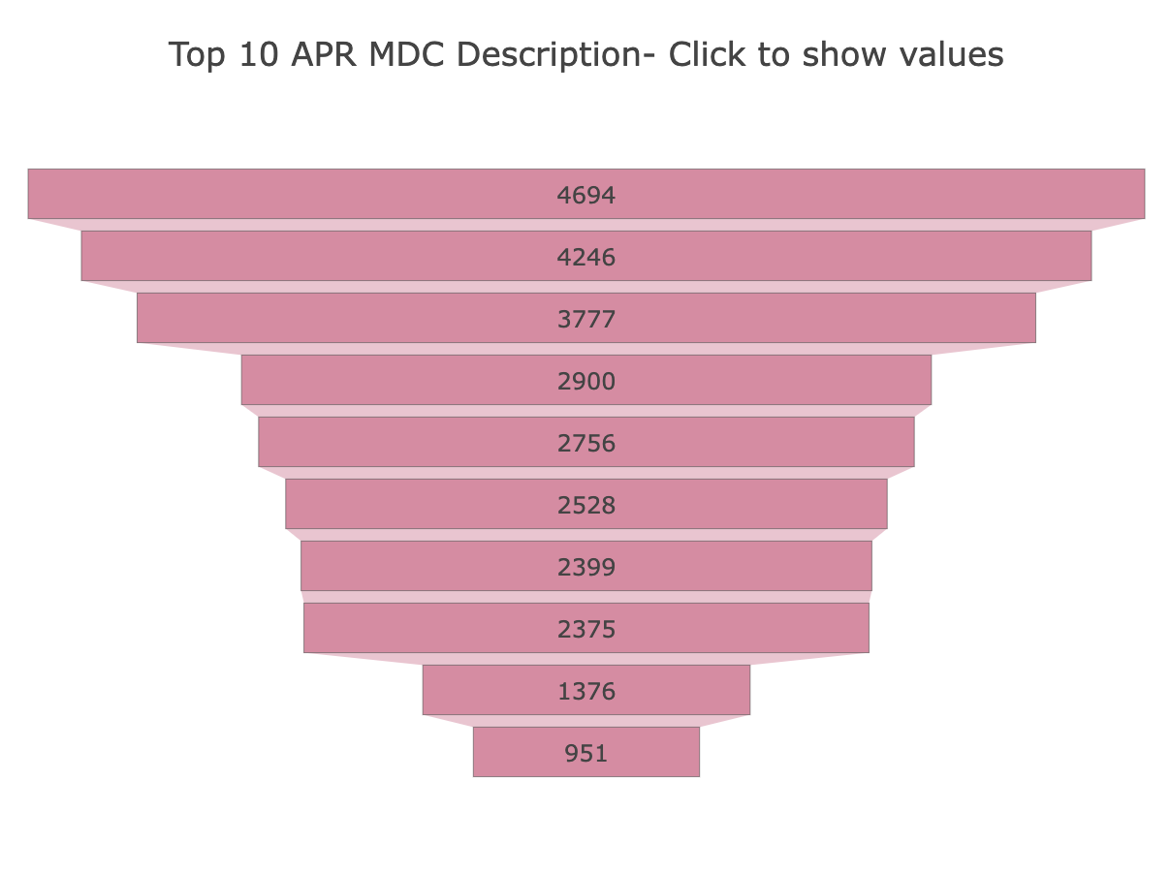
Data Dashboard
Displays the top 10 admission types for the selected hospital

Slide 10
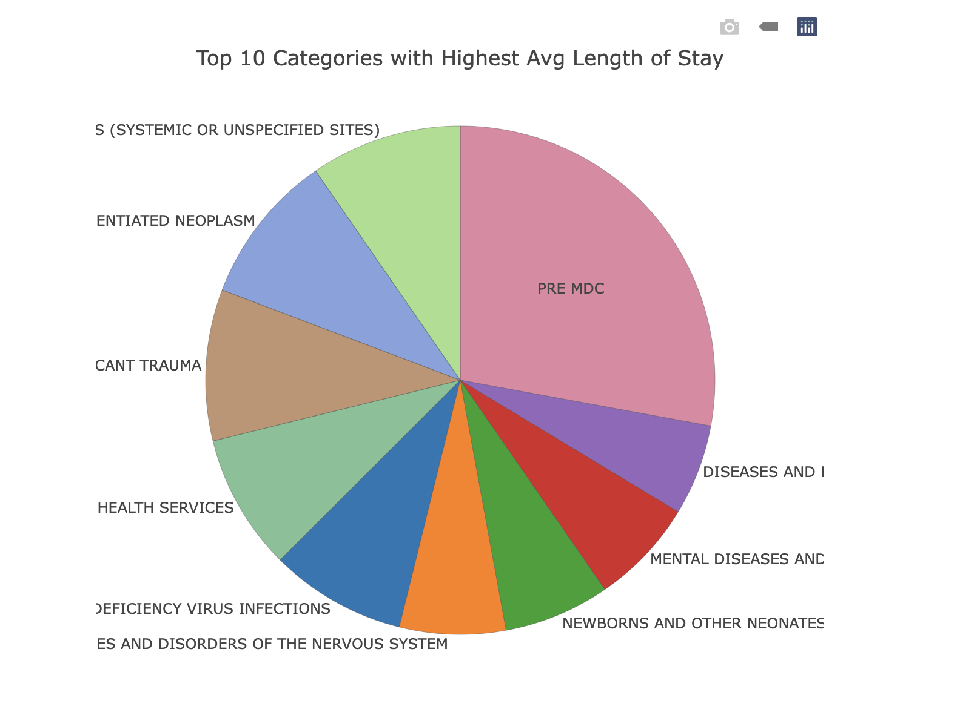
Data Dashboard
Presents a percentage of total discharges by admission type

Slide 11
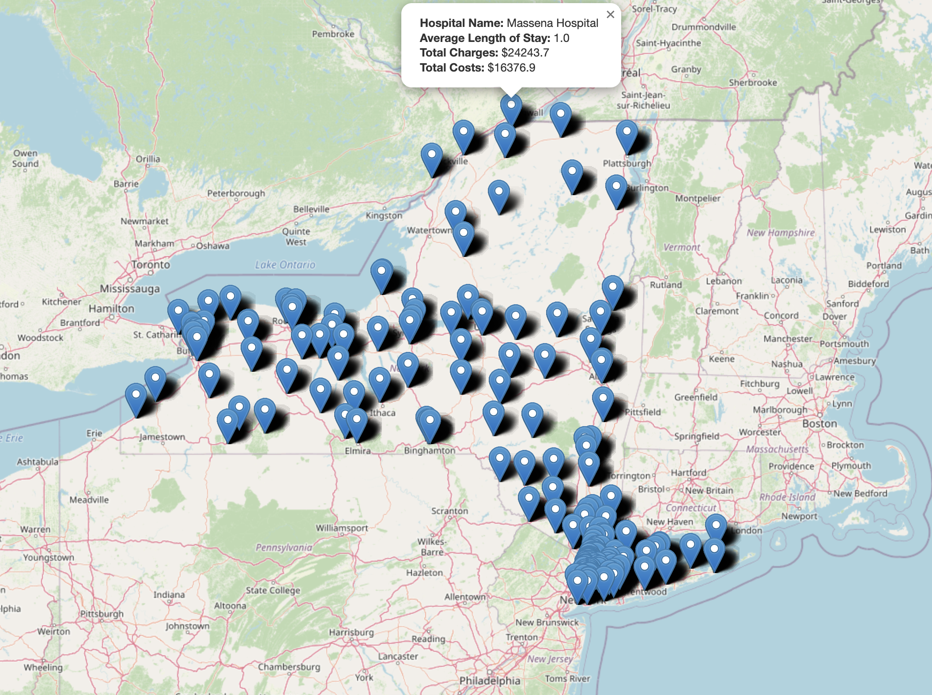
Marker Map - Government
Plots all facilities
On click displays markers with Average Length of Stay, Total Costs, and Total Charges

Slide 12
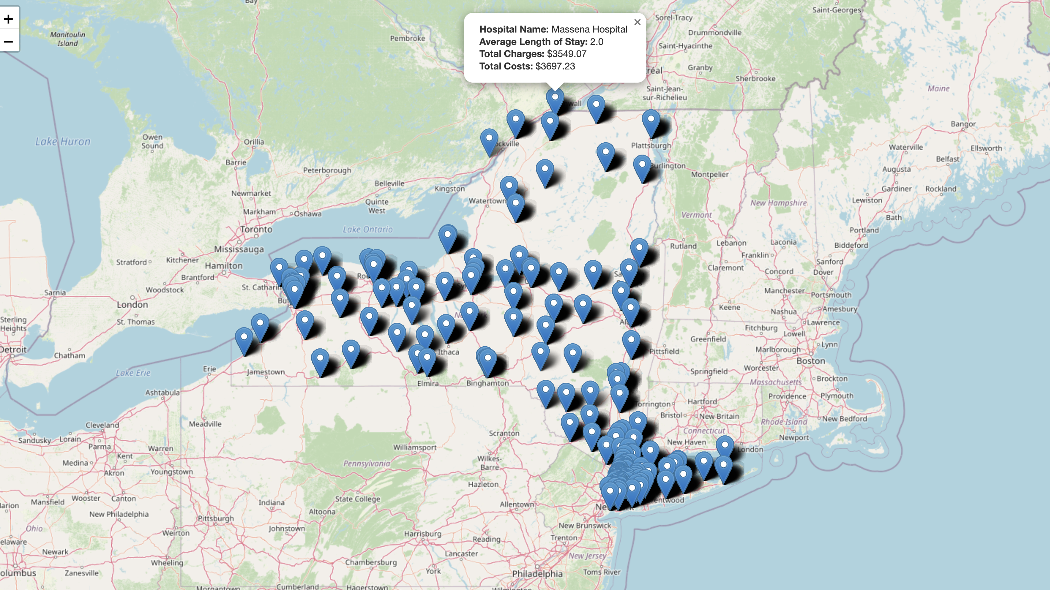
Marker Map - Private

Slide 13
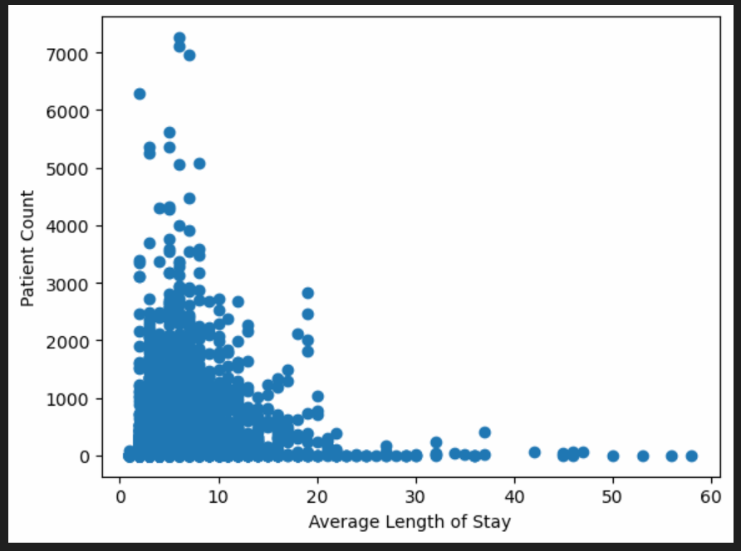
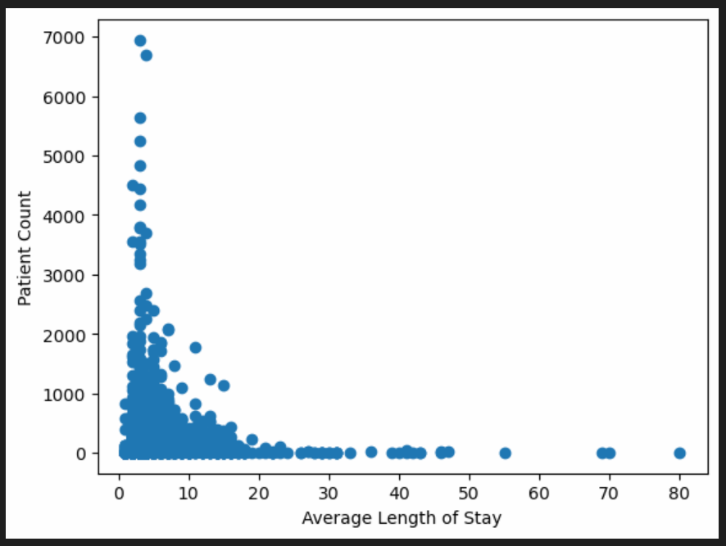
Scatterplots

Slide 14
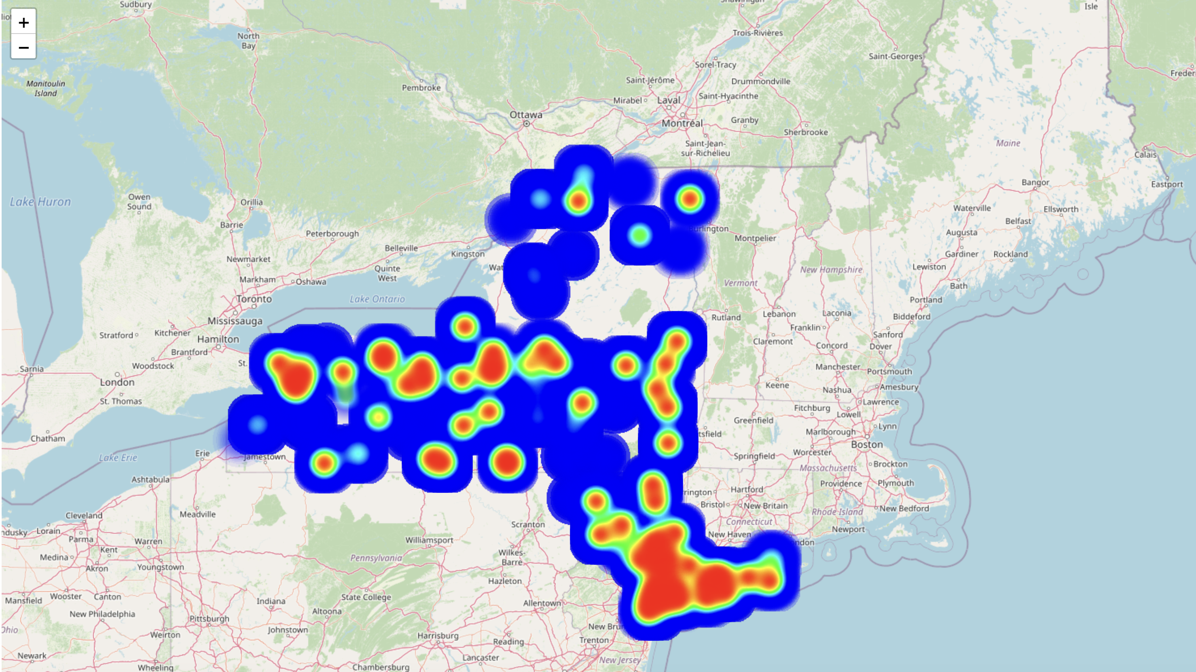
Heatmaps - Government

Slide 15
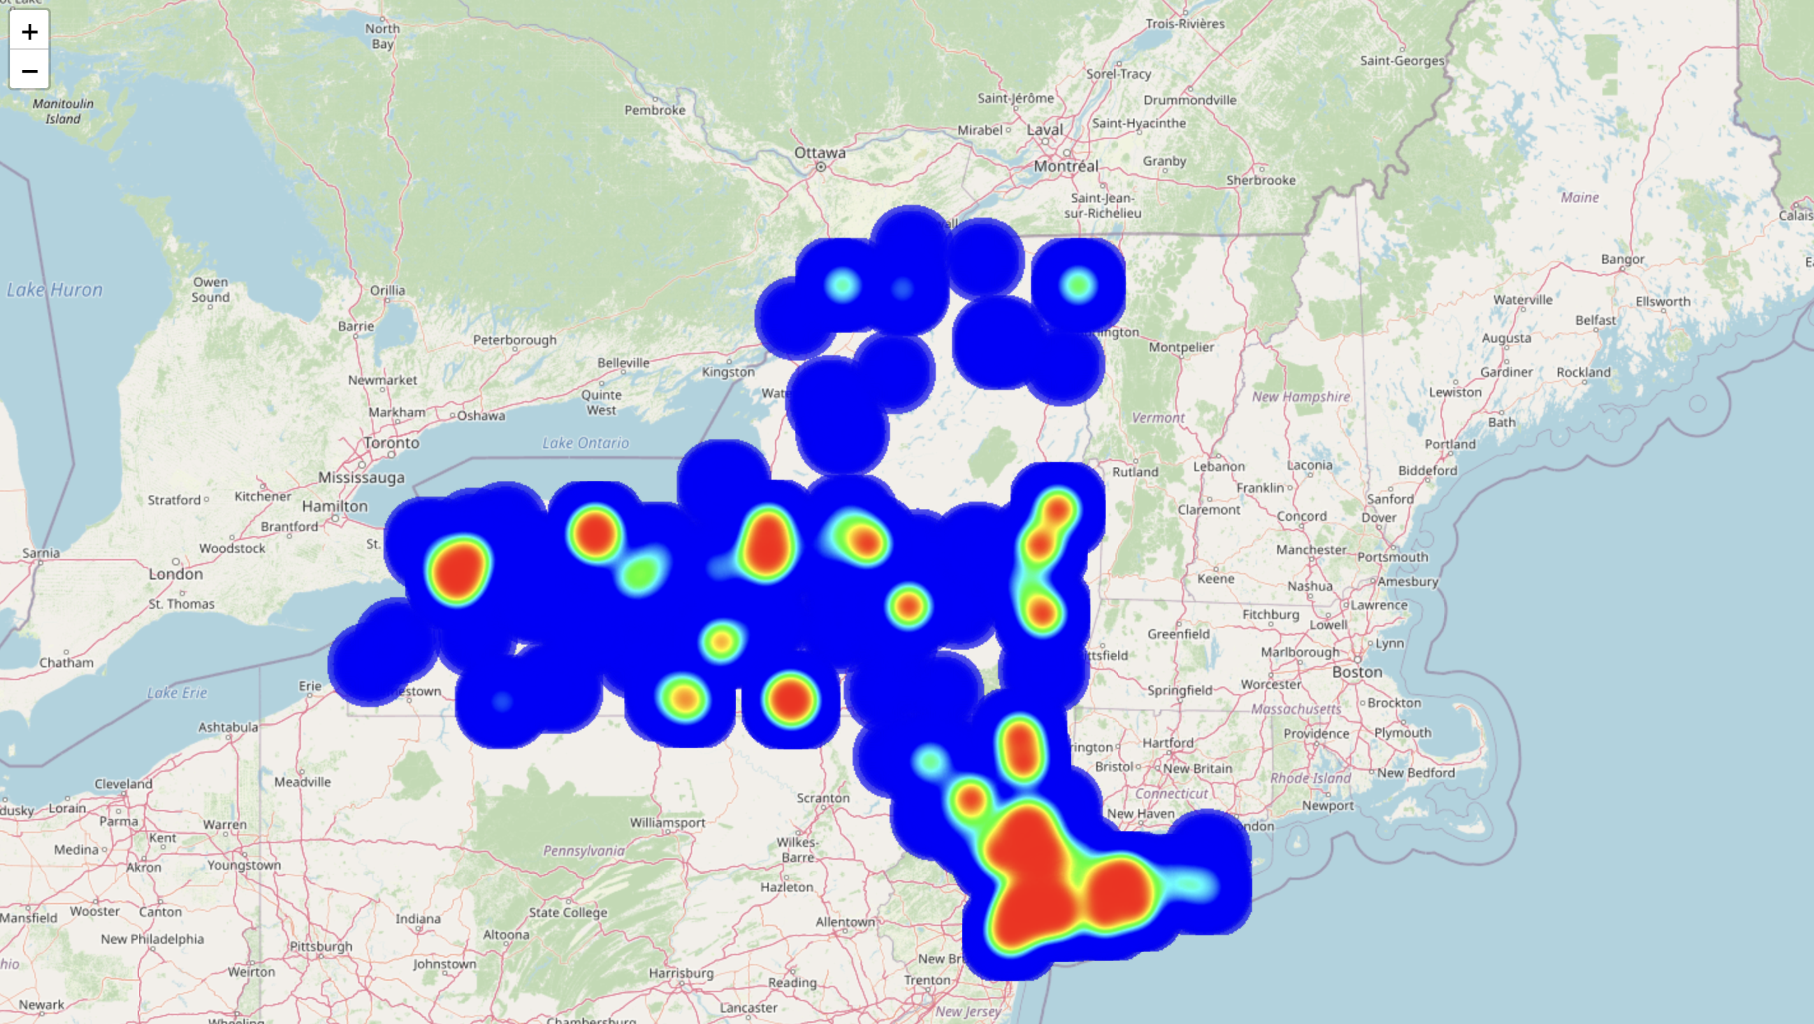
Heatmaps - Private

Slide 16
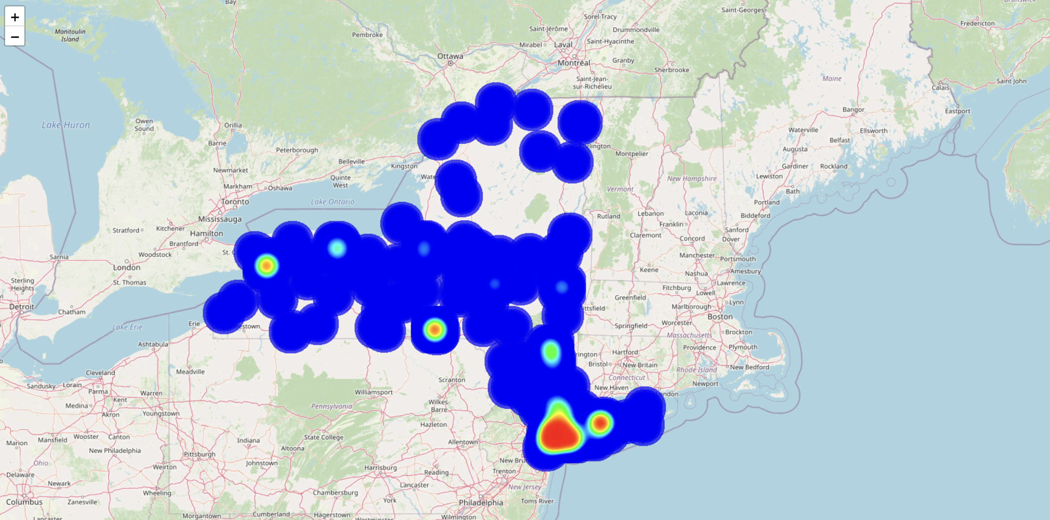
Heatmaps – Other Payment Types

Slide 17
Analysis and Implications
Resource Allocation: Variances in length of stay inform resource allocation strategies, enabling hospitals to optimize staffing and bed availability.
Financial Management: Length of stay directly influences costs; discerning differences between payer groups aids administrators in cost reduction and revenue enhancement efforts.
Quality of Care: Disparities in length of stay may signal variations in care quality, highlighting the need for equitable healthcare delivery.
Care Coordination and Discharge Planning: Longer stays can indicate inefficiencies in care coordination; analyzing length of stay assists in streamlining processes to improve patient outcomes.
Policy and Regulation: Length of stay data informs healthcare policy decisions, aiding policymakers in designing interventions to promote efficiency and quality across payer groups.

Slide 18
Possible Future Developments
Combining datasets to visualize differences between the two provider groups simultaneously
Adding historical data
Perform linear regression to find statistical significance of length of stay comparison

Slide 19
Conclusion - Dave
Our hypothesis is not null
Average length of stay is longer for those on public insurance plans than those with private insurance
Hospitals have less incentive to turn over beds that are paid for with public insurance funds
Public insurance rates are lower in general for inpatient hospital stays – therefore hospitals are paid less for serving these patients
Patients who utilize private insurance often pay more out-of-pocket, decreasing the frequency of long stays for this population

Slide 20

Questions?

